Slide 1
Lecture 9 – Python(Files)
By- Pratik Sanghvi

Slide 2
What is a file
A file is a container of data stored in a persistent storage(Hard Drive) which can be accessed later.
It can contain structured data(CSV, JSON etc.) or unstructured data(free text)
The size of the file can be small(like 1KB) or large like 240GB etc
Text file has a ‘.txt’ extension. The extension specifies the structure of the data in the file(e.g. CSV)
Files are crucial when we need the program to have persistent data. It can be used to save the program state and also be an input to the program
Most of the programs seen until now were transient(output of program not stored), but using files we can make the program persistent by storing it in files
Program output can also be stored in databases or can be serialized using pickle.

Slide 3
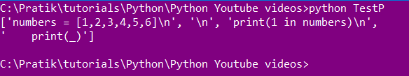

What is a text file
A string of characters combined together with not specific structure or length can be termed as a text file.
The extension of a text file is ‘.txt’
Text file can be read in python using open() construct
Program
Output

Slide 4
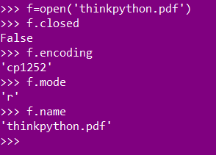
Attributes of file object
A file object has multiple attributes like encoding,mode , name etc
Following is a list of most used file objects
Closed – a Boolean value indicating whether the file is closed or not
Encoding – a character standard used by the file while creation(e.g. cp1252)
Mode – attribute listing the I/O mode in which the file is opened
Name - If the file object was created using open(), it will be the name of the file. Otherwise, some string that indicates the source of the file object.
Sample Attribute values

Slide 5
Popular file methods
Following are some popular file methods
Close() – method closes the file pointer reference
Next() - When a file is used as an iterator, typically in a for loop (for example, for line in f: print line), the next() method is called repeatedly. This method returns the next input line, or raises StopIteration when EOF is hit.
Read([size]) – Read at most size bytes from the file.
Readline([size]) – Optional. The number of bytes from the line to return. Default -1, which means the whole line.
Seek(offset[,whence]) – set files current position to the specified offset from the point of reference. Whence specifies the reference point.
0: sets the reference point at the beginning of the file – f.seek(23,0)
1: sets the reference point at the current file position – f.seek(23,1)
2: sets the reference point at the end of the file – f.seek(23,2)

Slide 6
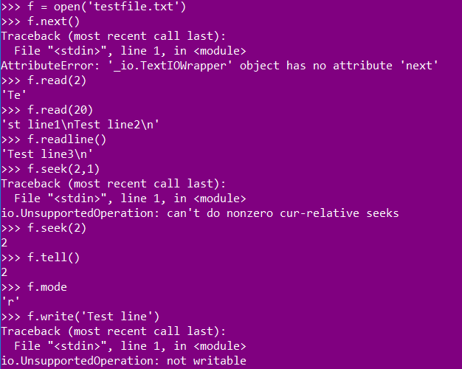
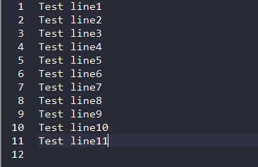
Popular file methods (cont.)
6. tell() – Return the file’s current position
7. write(str) – Write a string to the file
8. writelines(sequence) – Write a sequence of strings to the file.
Input file
Method Output

Slide 7
What is a directory
A directory is a container for any kind and size of files
Directory is helpful in establishing a tree like hierarchical structure
Helpful in establishing a structure in file organization(e.g. Data/94/12/04/CSV)
Directory is also know as a folder

